Slide 1
Advanced SQL – IMDB Dataset Analysis
A Reinforcement Project
By: Raghul Prasanth.M
Course:DA & DS

Slide 2
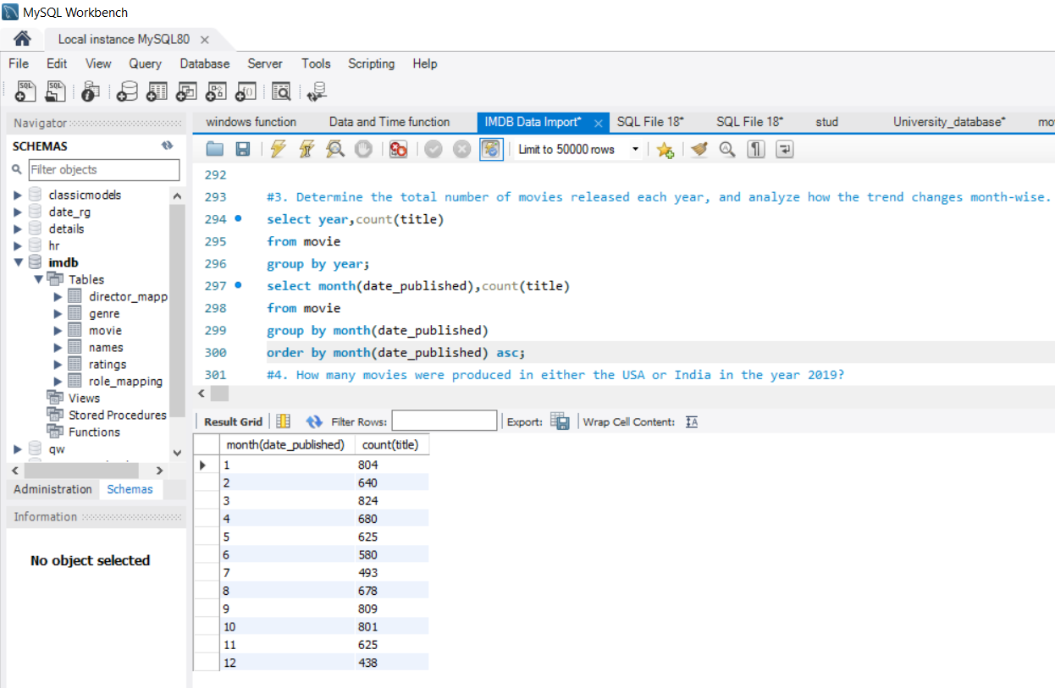
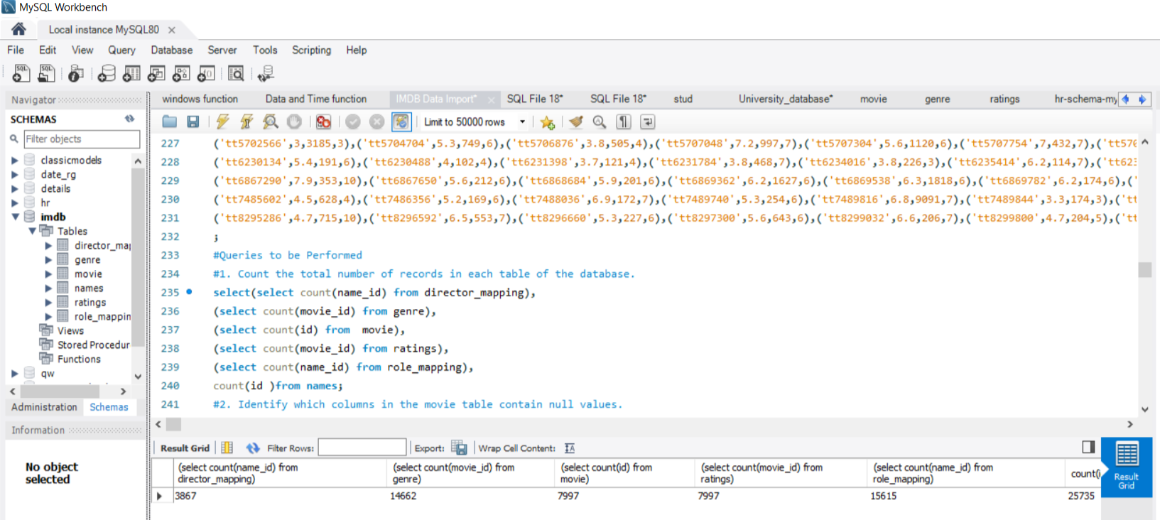
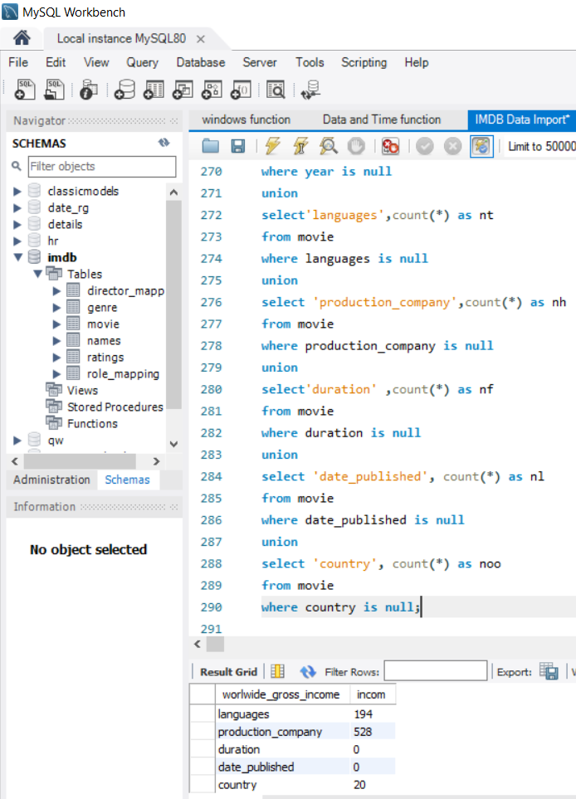
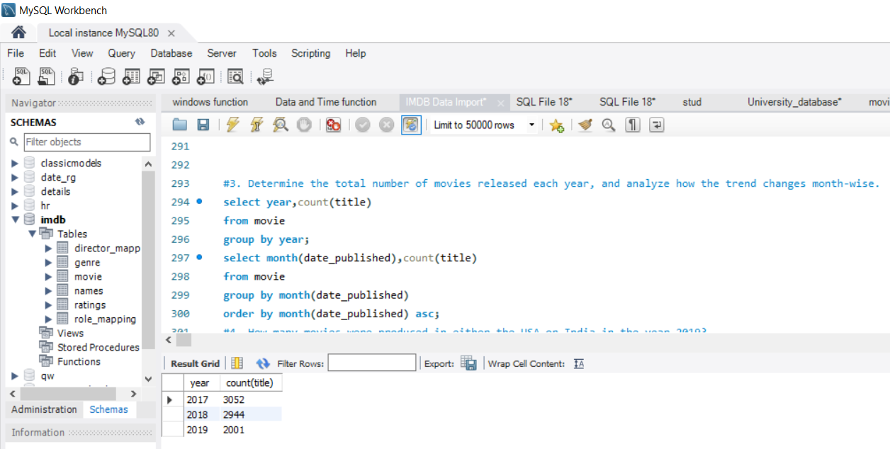
Introduction
This project analyzes a simplified version of the IMDB dataset.
It includes details about movies, genres, actors, directors, and ratings.
The goal is to reinforce SQL skills and extract meaningful insights.
Provide actionable business insights

Slide 3
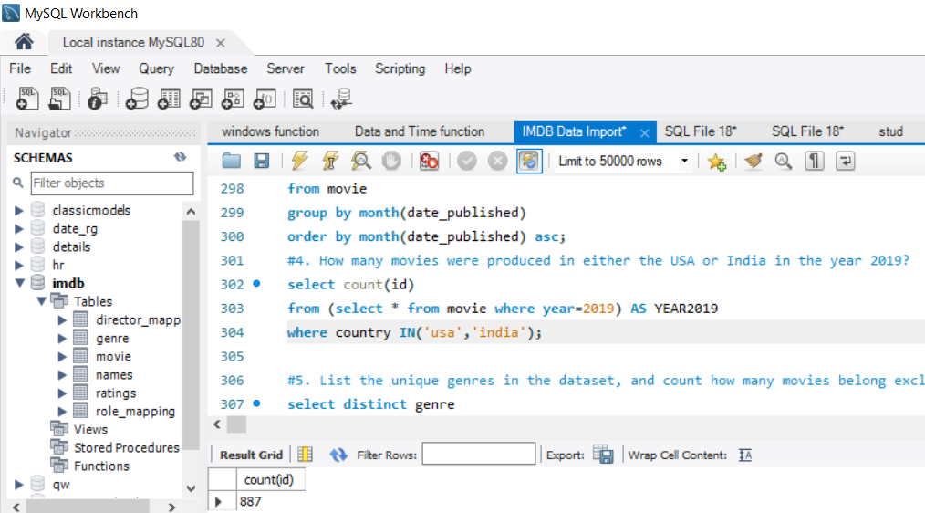
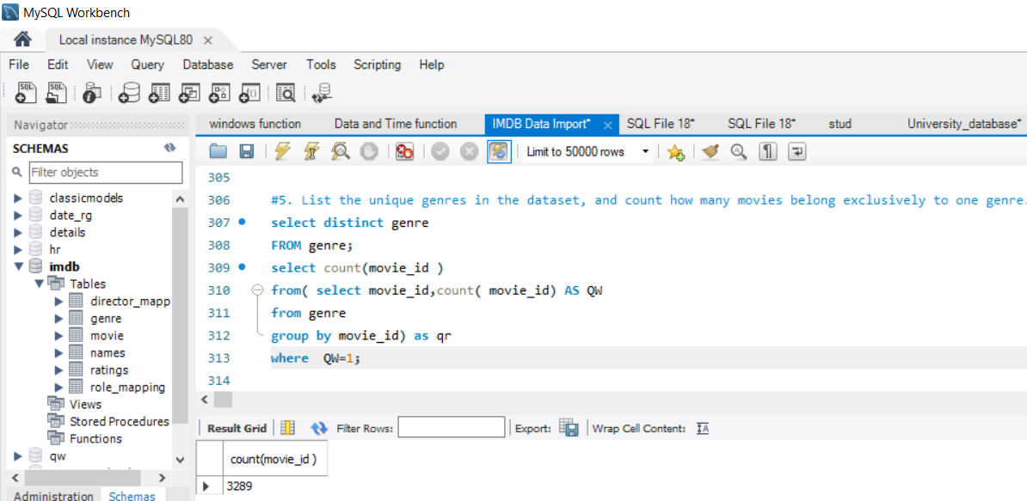
Dataset Structure
The dataset consists of six tables:
1. Movie – Basic movie details (title, year, duration, country, etc.)
2. Genre – Genres associated with each movie
3. Director Mapping – Links movies to directors
4. Role Mapping – Maps actors/actresses to movies
5. Names – Details about people (birthdates, height, known movies)
6. Ratings – Movie ratings, total votes, and median ratings

Slide 4
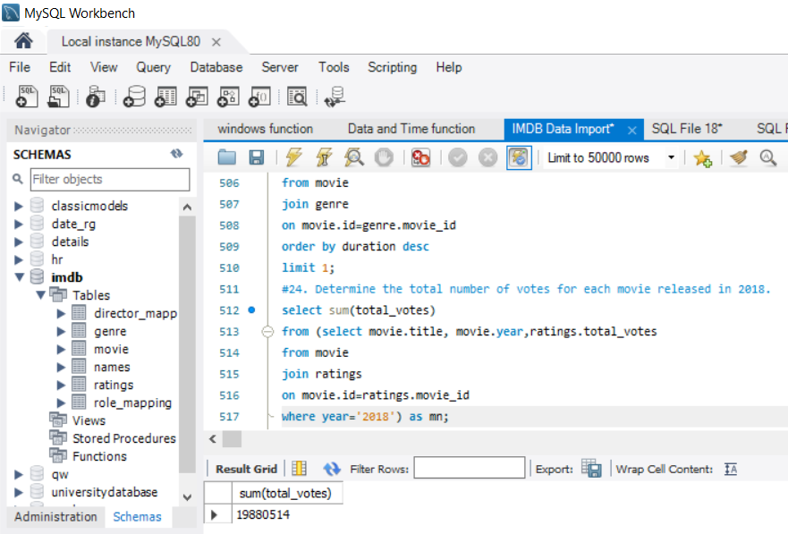
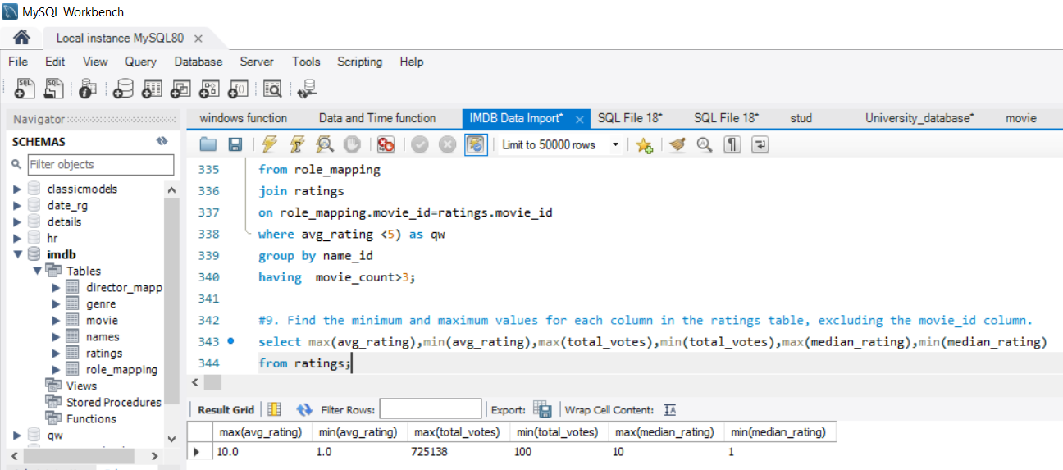
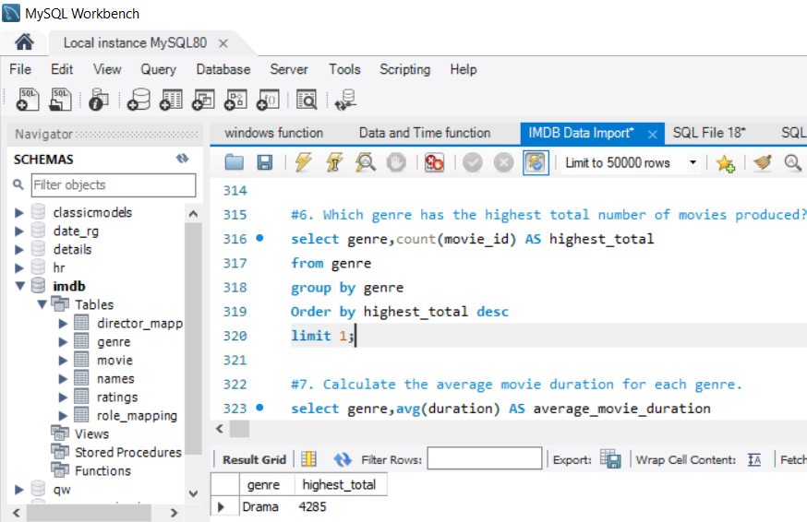
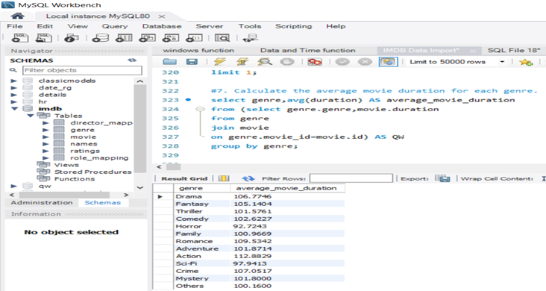
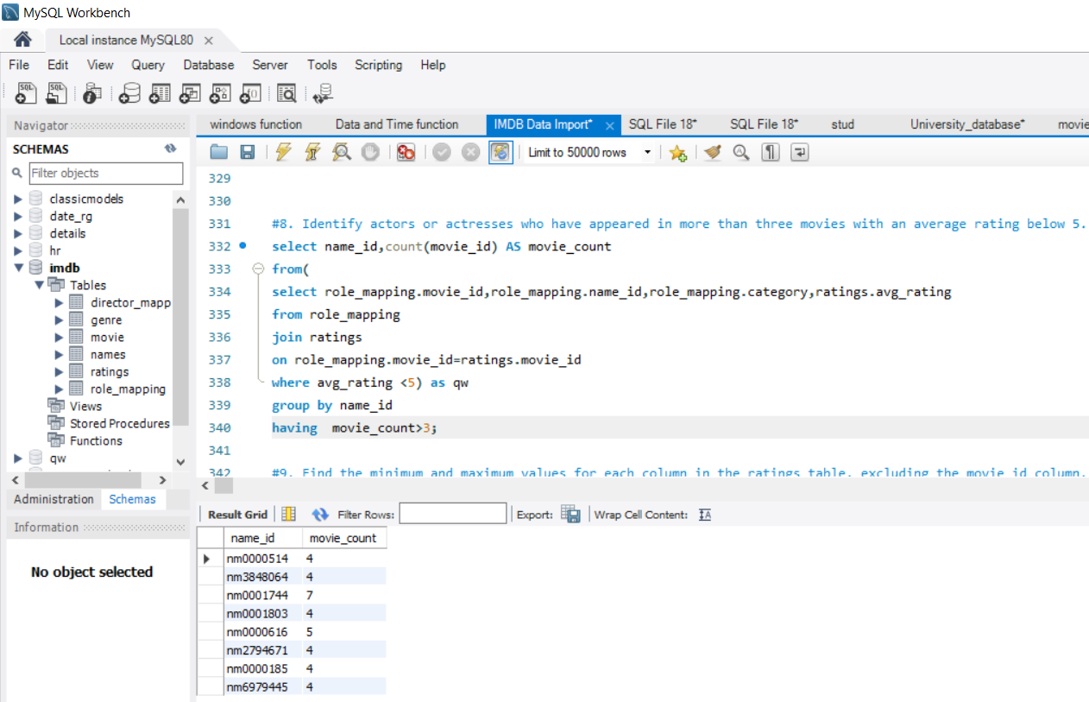
Project Objectives
• Reinforce key SQL concepts (joins, aggregation, filtering, grouping, order by,
limit)
• Analysis IMDB data to extract meaningful insights
• Document findings and improve data presentation skills
• Exploring trends in movies

Slide 5
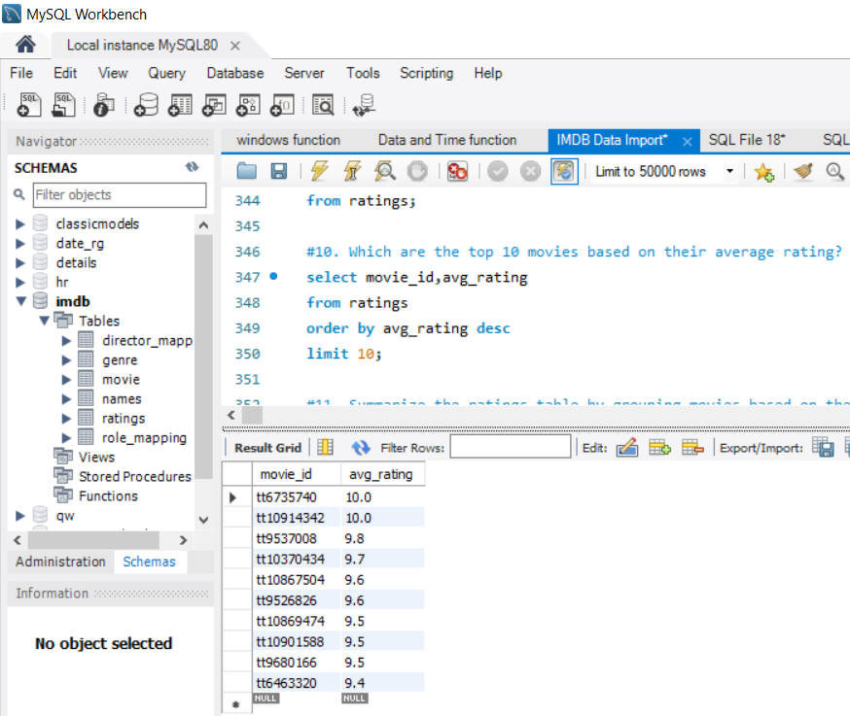
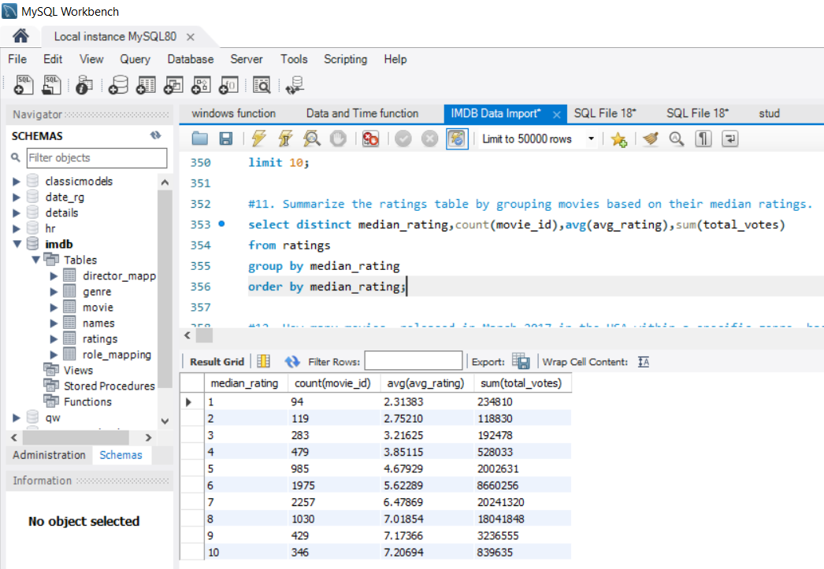
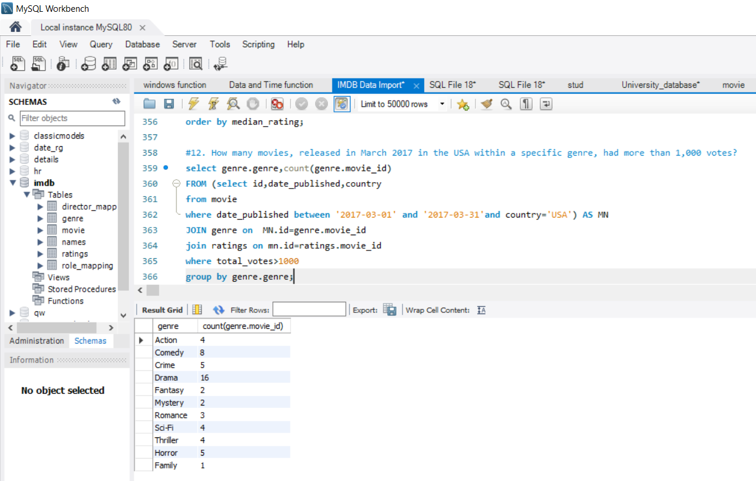
Key SQL Queries
• Counting total records in each table
• Identifying columns with NULL values
• Analyzing yearly and monthly movie release trends
• Finding the most common genres and top-rated movies
• Comparing average votes received by German vs. Italian movies are 12928.4357 and 11960.4673

Slide 6
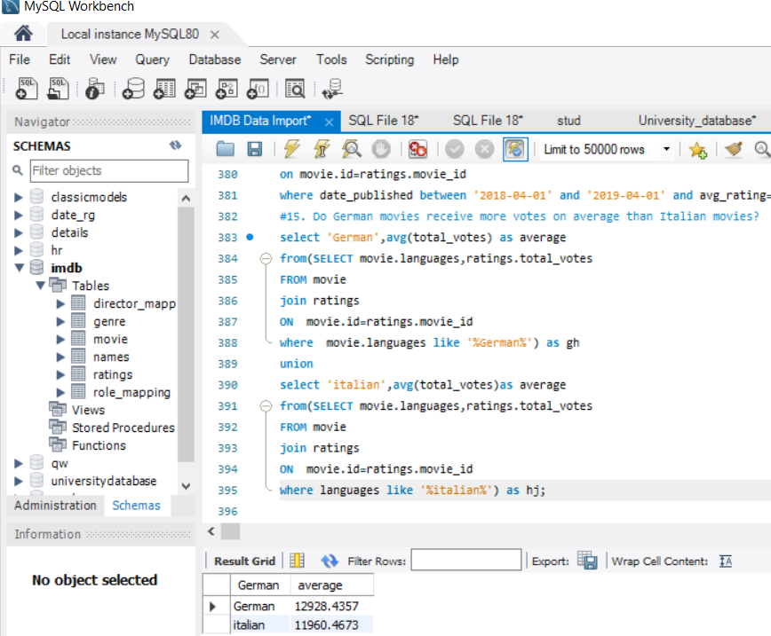
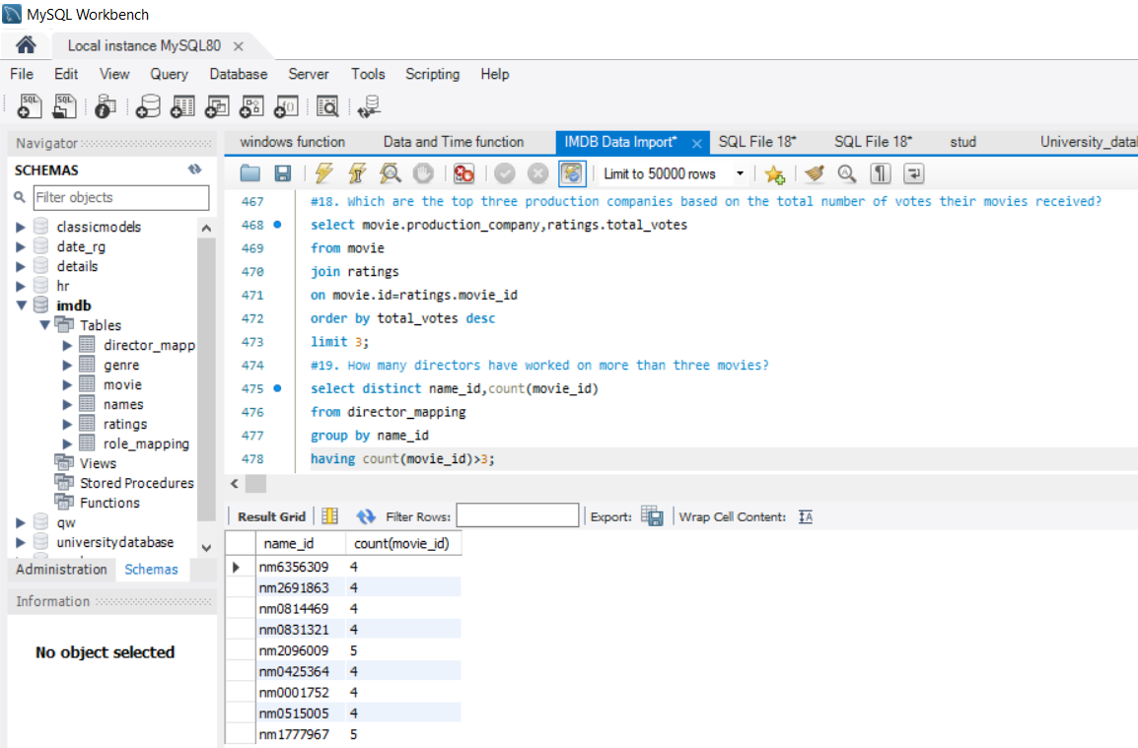
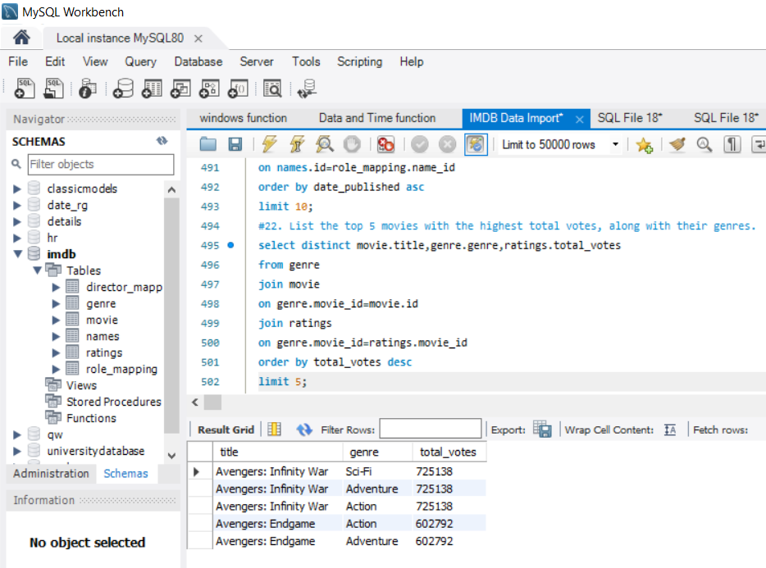
Findings & Insights (Part 1)
• The highest number of movies were released in [2017].
• The most common genre is [Drama] with 4285 movie count.
• Movies with 'The' in their title tend to have higher ratings.
• The longest movie in the dataset is [El Pampero Cine] with [808] minutes.

Slide 7
Findings & Insights (Part 2)
• Top production companies based on total votes are:
1. Marvel Studios with 725138 votes
2. Marvel Studios with 602792 votes
3. Twentieth Century Fox with 586106 votes
• The top two actors with movies rated 8 or higher are [Savas Barutçu] and [Cihan Köse].
• Average movie duration varies across genres, with [Drama] having the longest movies.

Slide 8

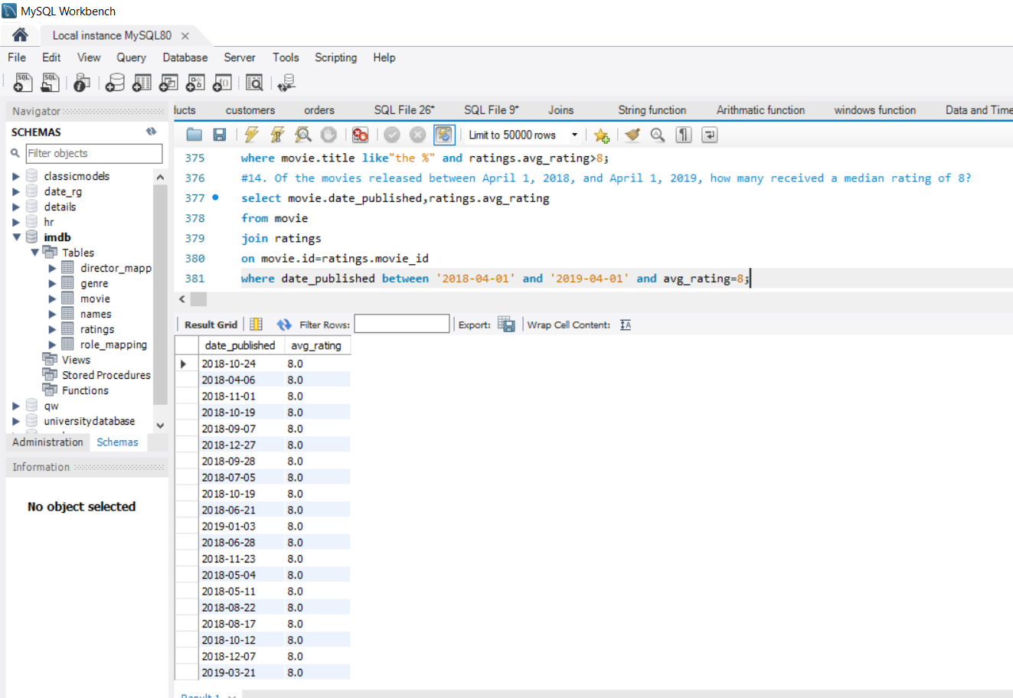
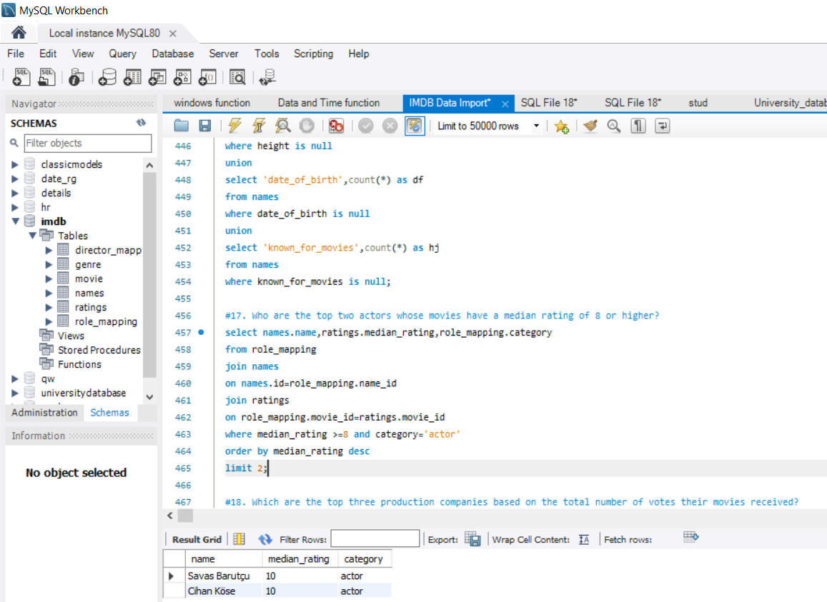
Challenges & Learnings
• Handling missing values in key tables
• Optimizing SQL queries for large datasets.
• Understanding IMDB rating trends and data patterns.

Slide 9
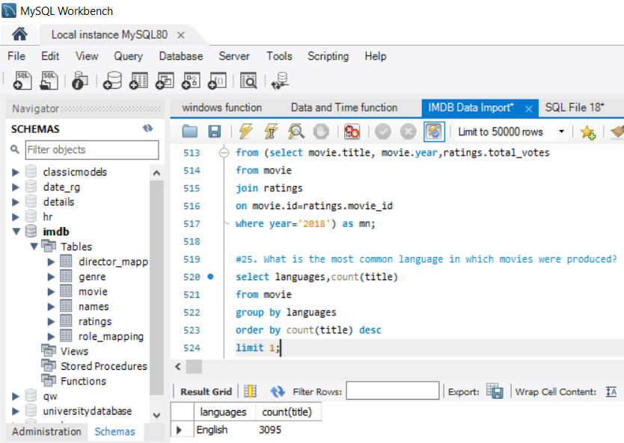
Conclusion
• The IMDB dataset provides rich insights into movie trends.
• SQL techniques such as joins, aggregation, and filtering were essential.
• Future work could include deeper analysis on actors’ career trends.

Slide 10
Question & Answer
• Thank you for your time!
• Questions or discussions are welcome.

